Slide 1
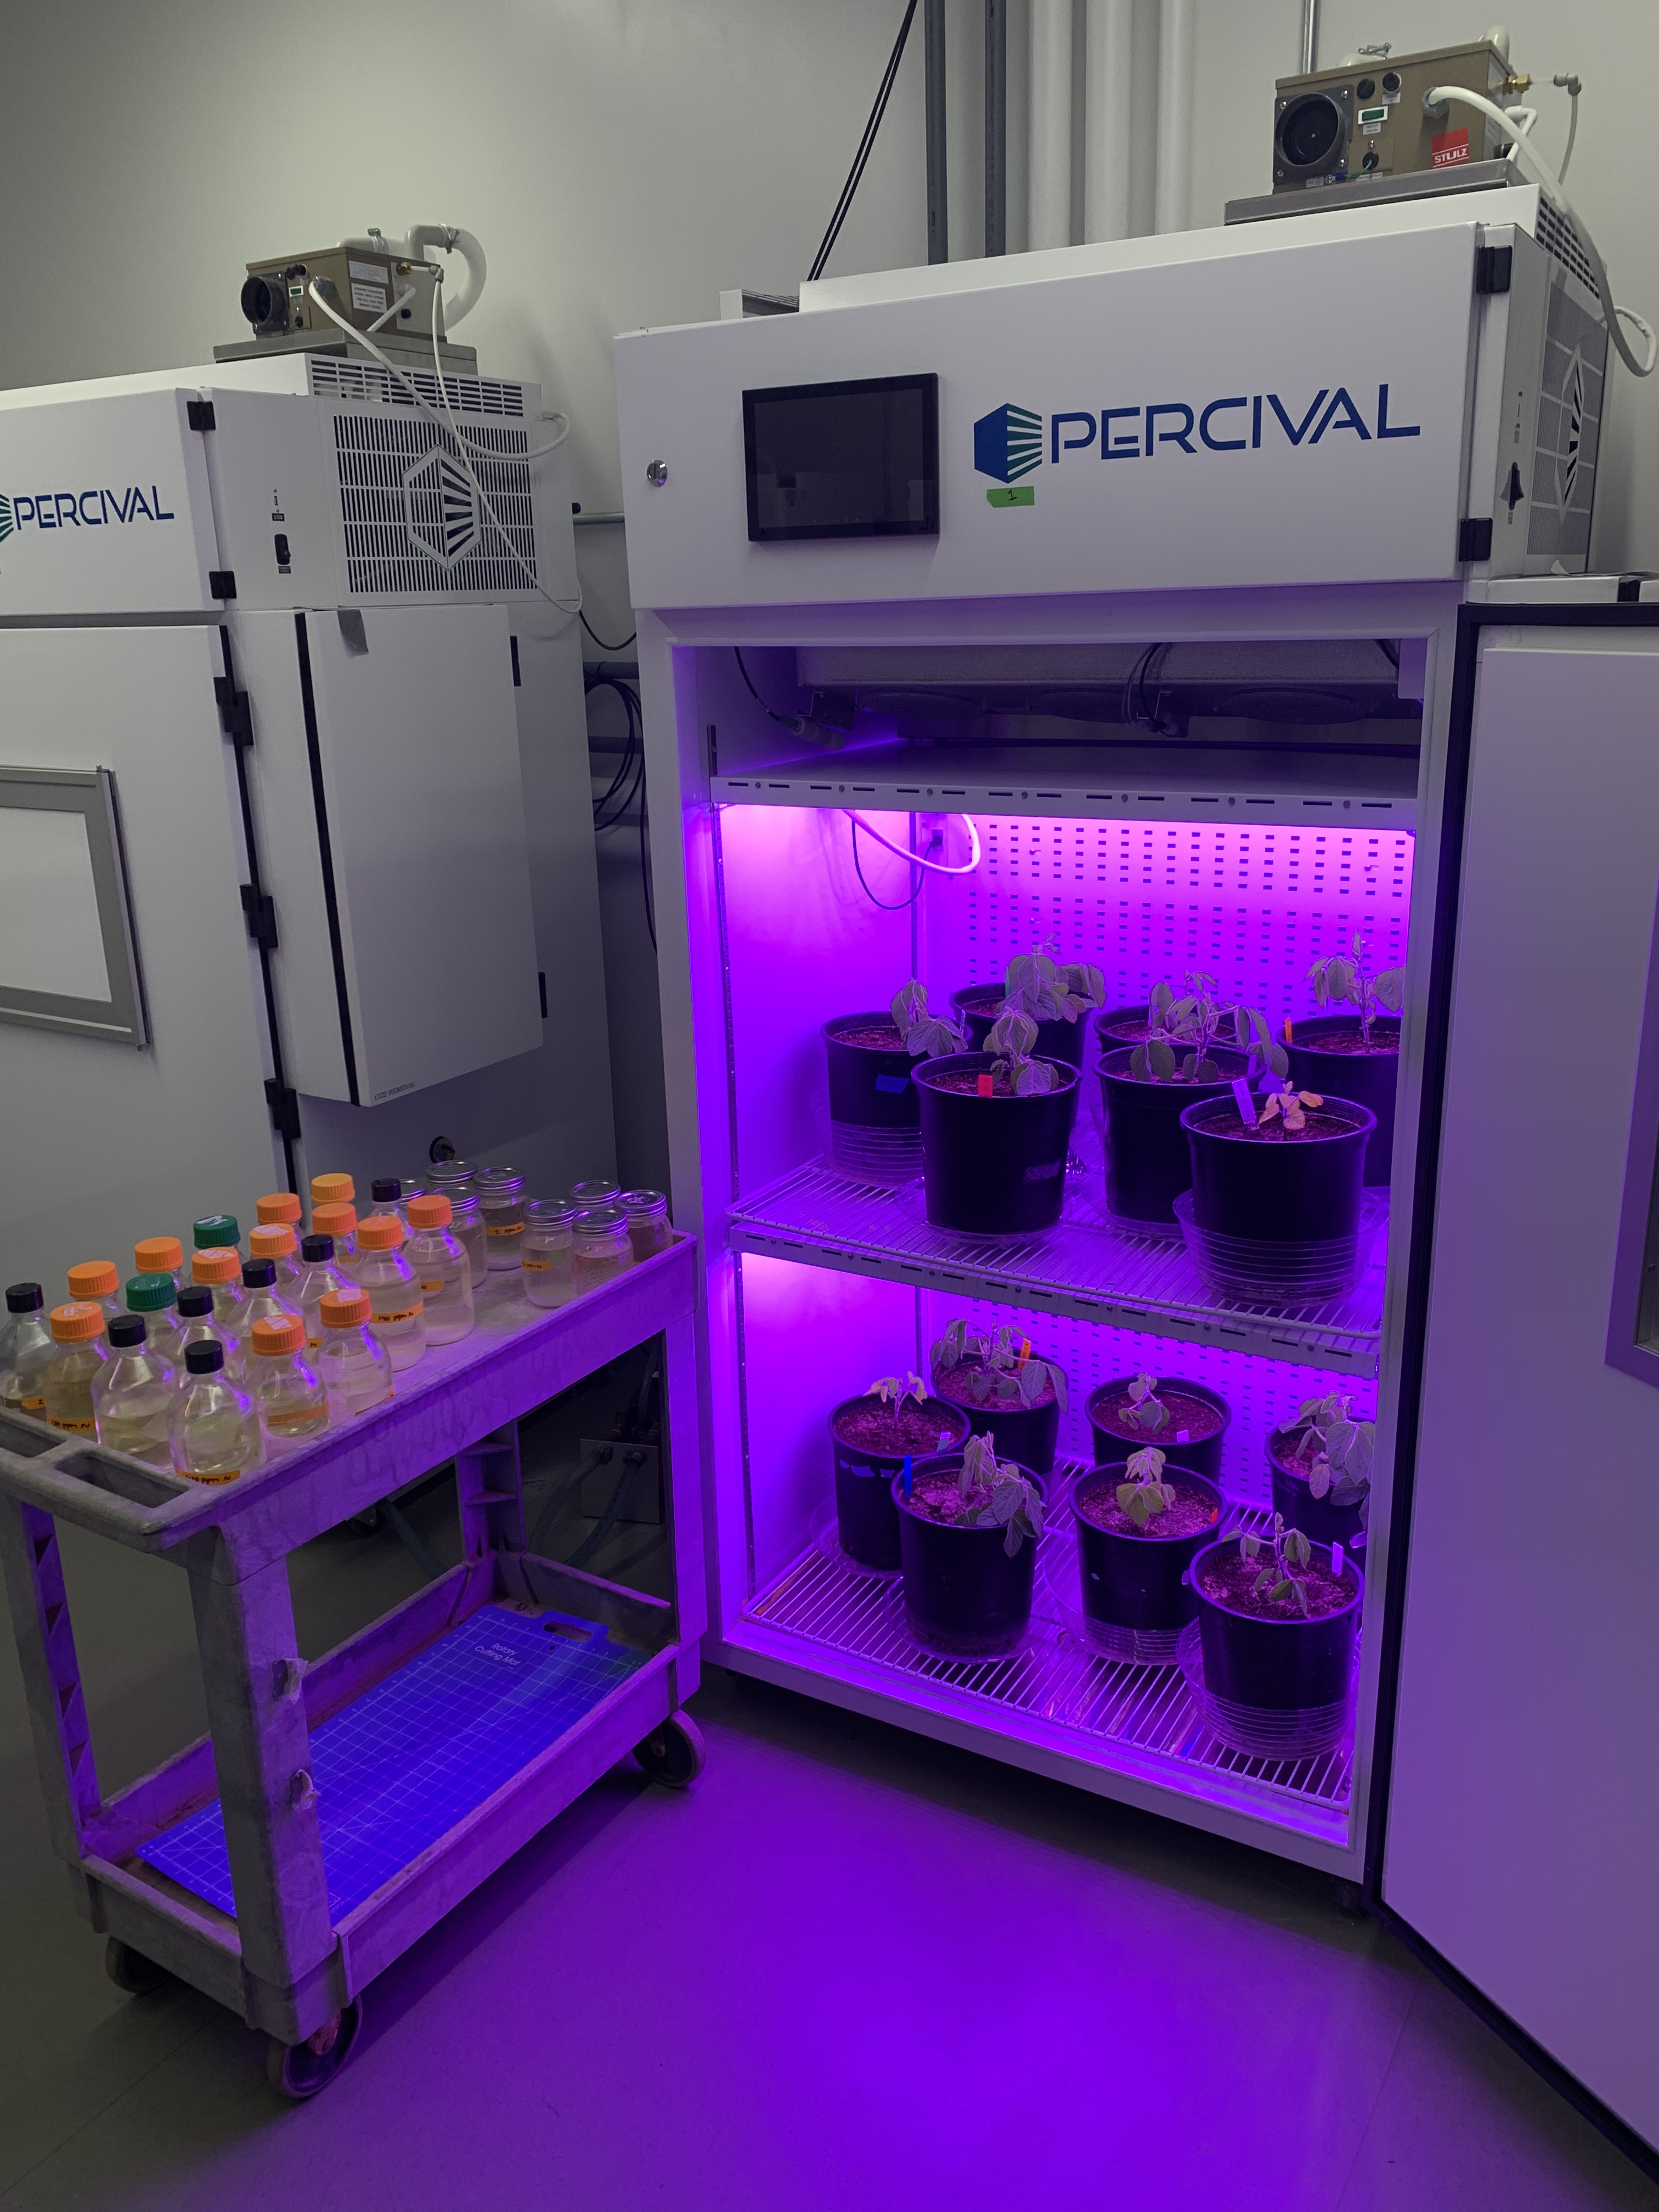





Nitrogen supply and demand control plant responses to elevated CO₂ at difference scales
Evan
Perkowski
Ezinwanne
Ezekannagha
Nick
Smith

Slide 2
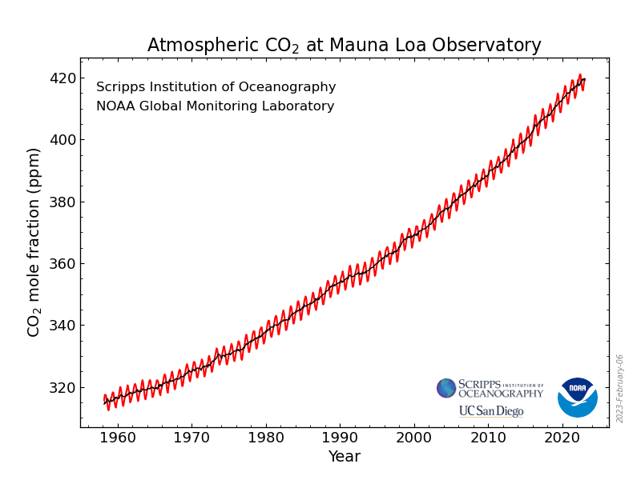
https://gml.noaa.gov/ccgg/trends/

Slide 3
33% increase in CO₂ concentration since 1960
61% of this increase has occurred since 1990
https://gml.noaa.gov/ccgg/trends/

Slide 4
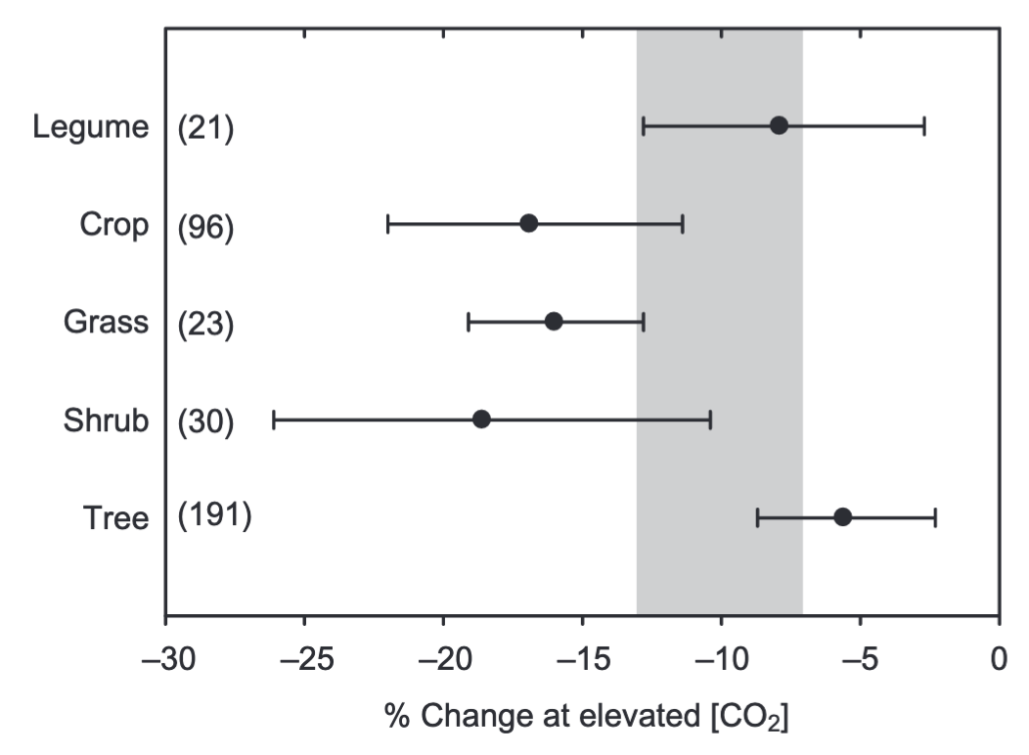
Plants grown under elevated CO₂ exhibit reductions in photosynthetic capacity
Photosynthetic capacity
Ainsworth & Rogers (2007) PC&E

Slide 5
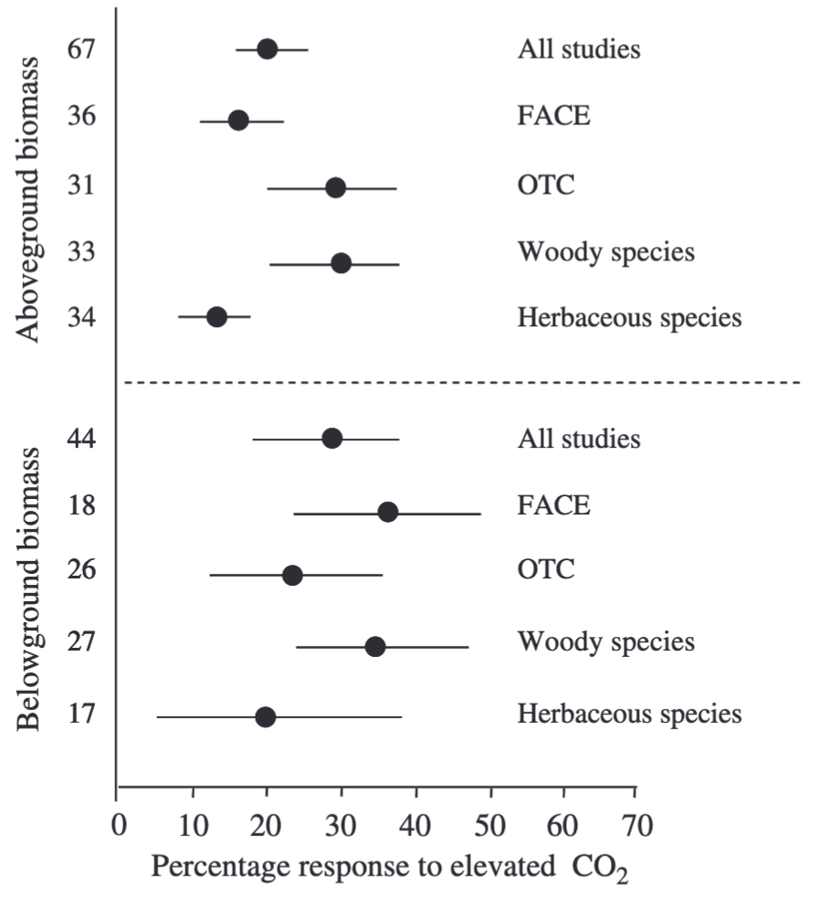
Reduced photosynthetic capacity under elevated CO₂ often corresponds with increased whole-plant growth
Aboveground biomass
Belowground biomass
de Graaf et al. (2006) Global Change Biology

Slide 6
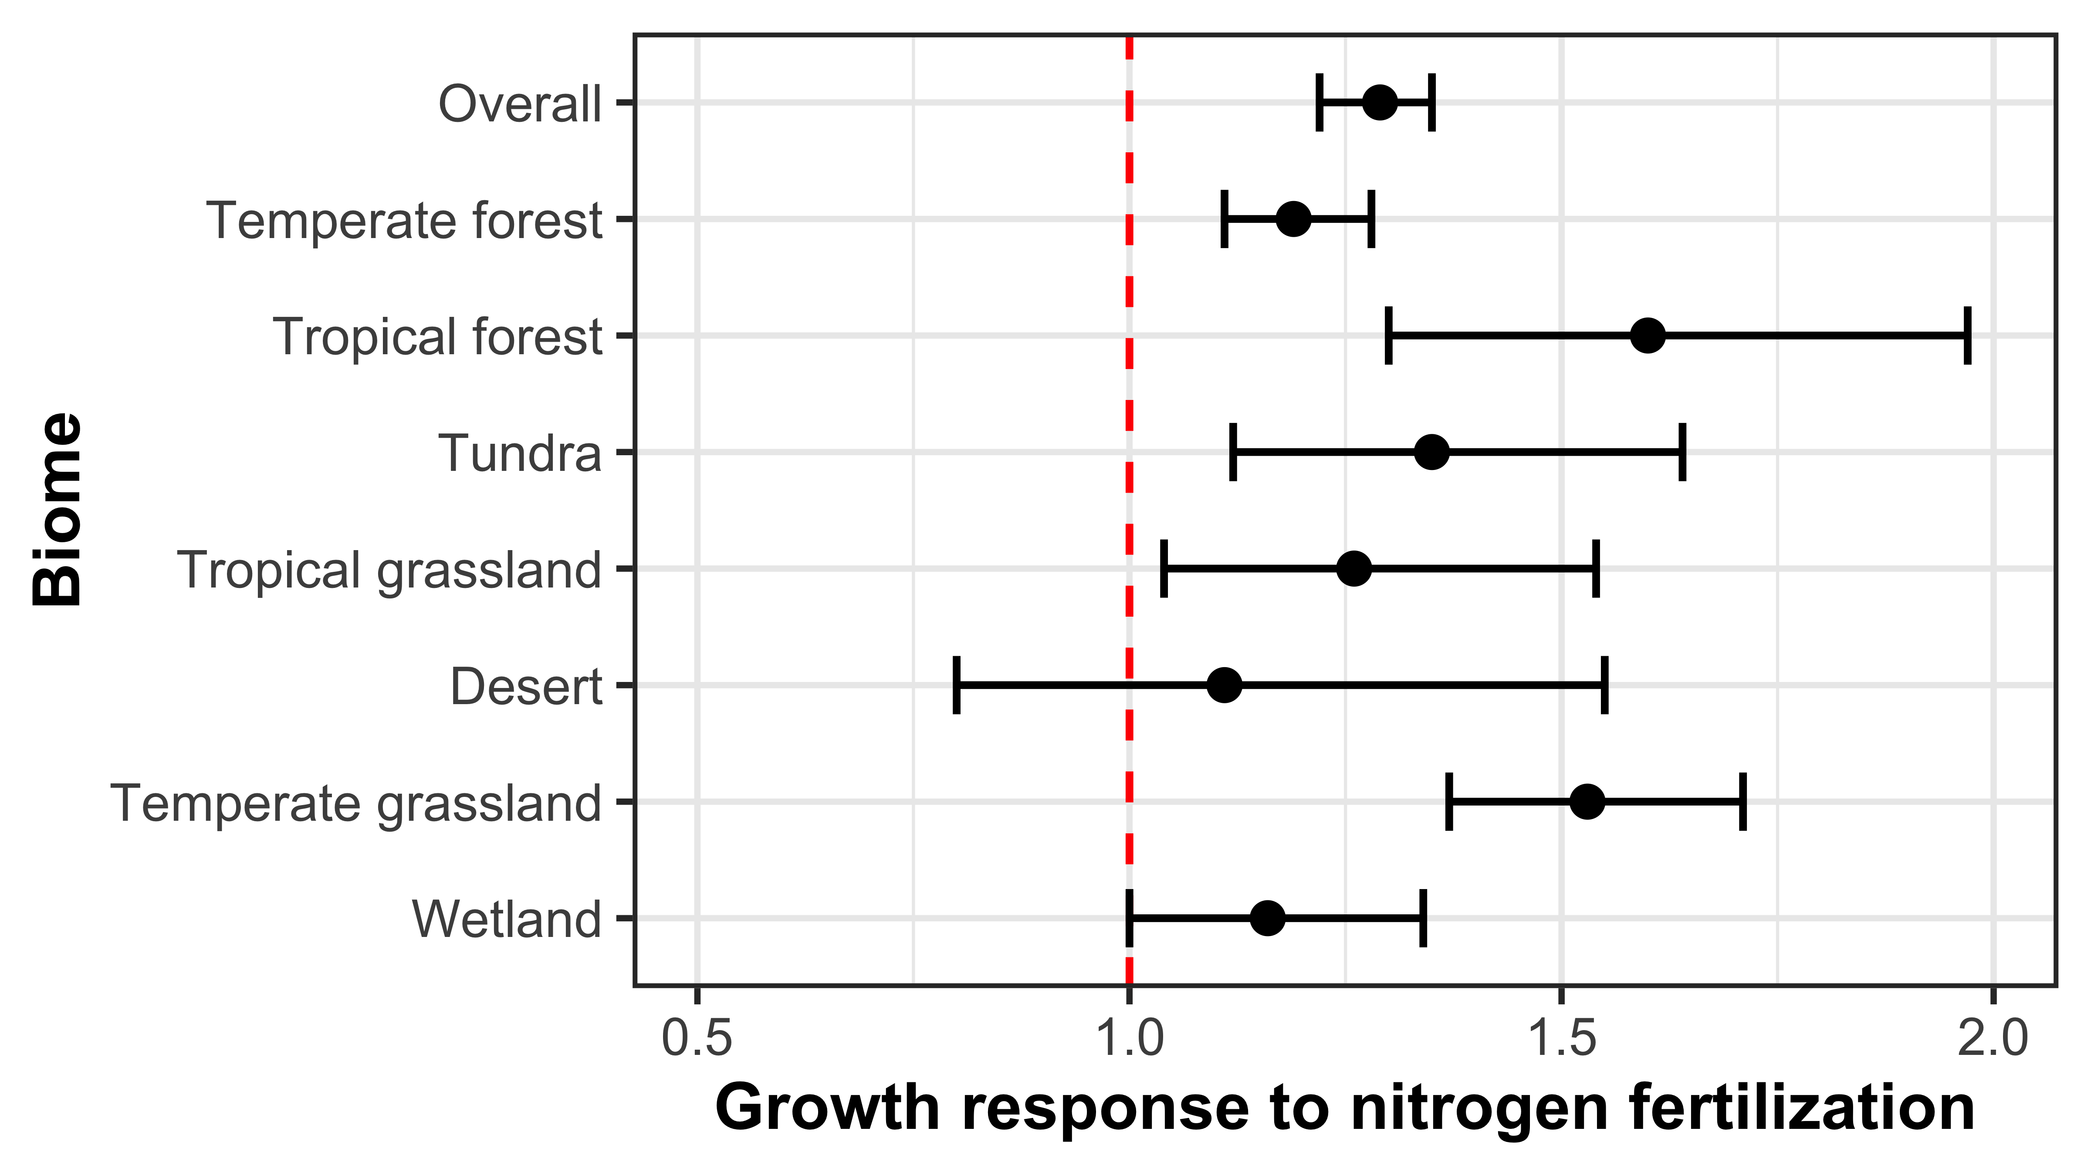
Some have hypothesized that nitrogen availability regulates plant responses to elevated CO₂
Figure adapted from Table 1 in LeBauer & Treseder (2008) Ecology
Notes:
The idea behind this is that nitrogen availability has been shown to limit net primary productivity globally

Slide 7
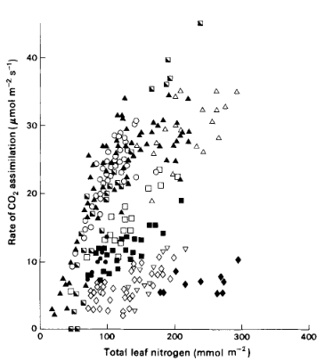
Some have hypothesized that nitrogen availability regulates plant responses to elevated CO₂
Figure adapted from Table 1 in LeBauer & Treseder (2008) Ecology
Evans (1989) Photosynthesis Research
Notes:
And that this response might be at least partly driven by positive relationships between soil nitrogen availability, leaf nitrogen content, and photosynthetic capacity

Slide 8
Some have hypothesized that nitrogen availability regulates plant responses to elevated CO₂
Increased demand to build and maintain photosynthetic enzymes
might deplete plant-available soil N pools
Figure adapted from Table 1 in LeBauer & Treseder (2008) Ecology
Evans (1989) Photosynthesis Research
Notes:
Under elevated CO2, some have hypothesized that increased demand to build and maintain photosynthetic enzymes might increase plant nitrogen uptake rates that should eventually deplete plant-available soil N pools as nitrogen becomes stored in longer living tissues

Slide 9
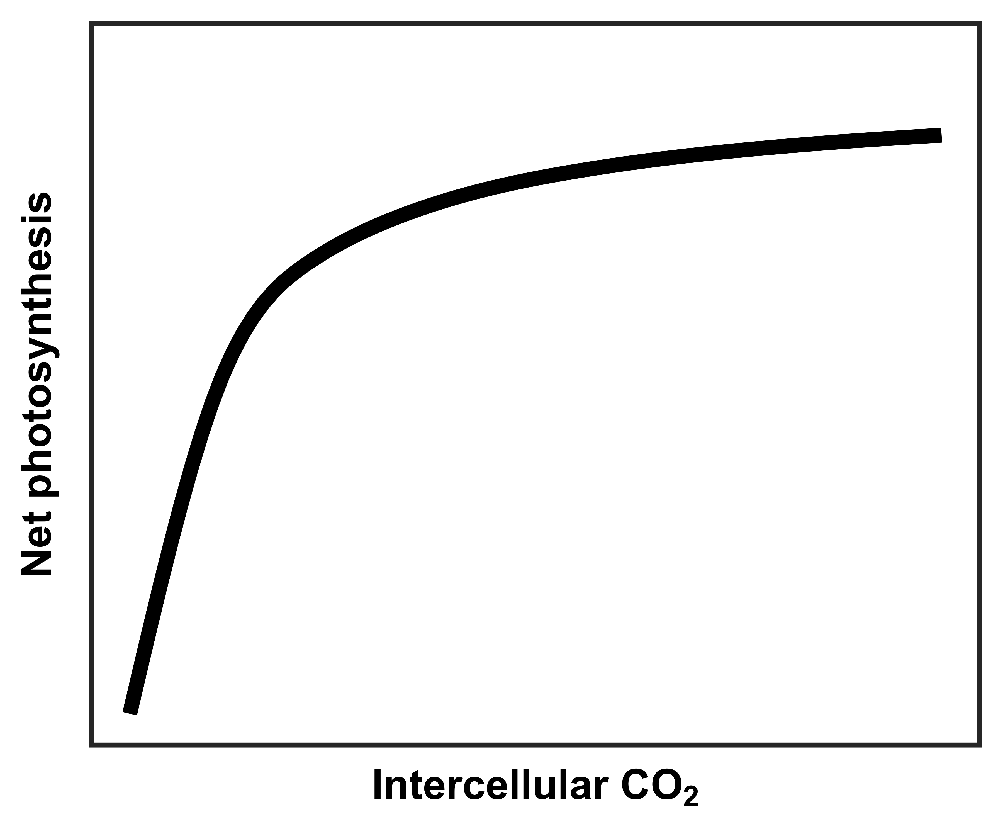
However, an alternative hypothesis suggests that plant demand to build and maintain photosynthetic enzymes drives the leaf response to CO₂
Figure adapted from Moore et al. (1999) PC&E
Notes:
Plants respond instantaneously to changes in intercellular CO2

Slide 10
However, an alternative hypothesis suggests that plant demand to build and maintain photosynthetic enzymes drives the leaf response to CO₂
Rubisco-limited photosynthesis
(A_{c})
Figure adapted from Moore et al. (1999) PC&E
Notes:
Plants respond instantaneously to changes in intercellular CO2
Under low CO2 concentrations, net photosynthesis linearly increases due to net photosynthesis rates being limited by CO2 and Rubisco carboxylation rates

Slide 11
However, an alternative hypothesis suggests that plant demand to build and maintain photosynthetic enzymes drives the leaf response to CO₂
RuBP-limited photosynthesis
(A_{j})
Rubisco-limited photosynthesis
(A_{c})
Figure adapted from Moore et al. (1999) PC&E
Notes:
Plants respond instantaneously to changes in intercellular CO2
Under low CO2 concentrations, net photosynthesis linearly increases due to net photosynthesis rates being limited by CO2 and Rubisco carboxylation rates
As intercellular CO2 concentrations increase, leaves become saturated with CO2 substrate.
Thus, net photosynthesis rates begin to become limited by how quickly RuBP regenerates (note from practice talk: electron transport for RuBP regeneration), which is a function of light availability
Rubisco is nitrogen-rich and therefore nutritionally expensive to build and maintain​

Slide 12
However, an alternative hypothesis suggests that plant demand to build and maintain photosynthetic enzymes drives the leaf response to CO₂
RuBP-limited photosynthesis
(A_{j})
Rubisco-limited photosynthesis
(A_{c})
net photosynthesis
at ambient CO₂
A_{c} = A_{j}
Figure adapted from Moore et al. (1999) PC&E
Notes:
Therefore, plants may strive to optimally allocate nitrogen to Rubisco to maximize nitrogen allocation to other structures and functions
such that
net photosynthesis rates are equally limited by Rubisco- and RuBP-limited photosynthesis rates (Ac = Aj)​
Net photosynthesis rate here indicates the net photosynthesis rate of a plant growing under its acclimated growing conditions

Slide 13
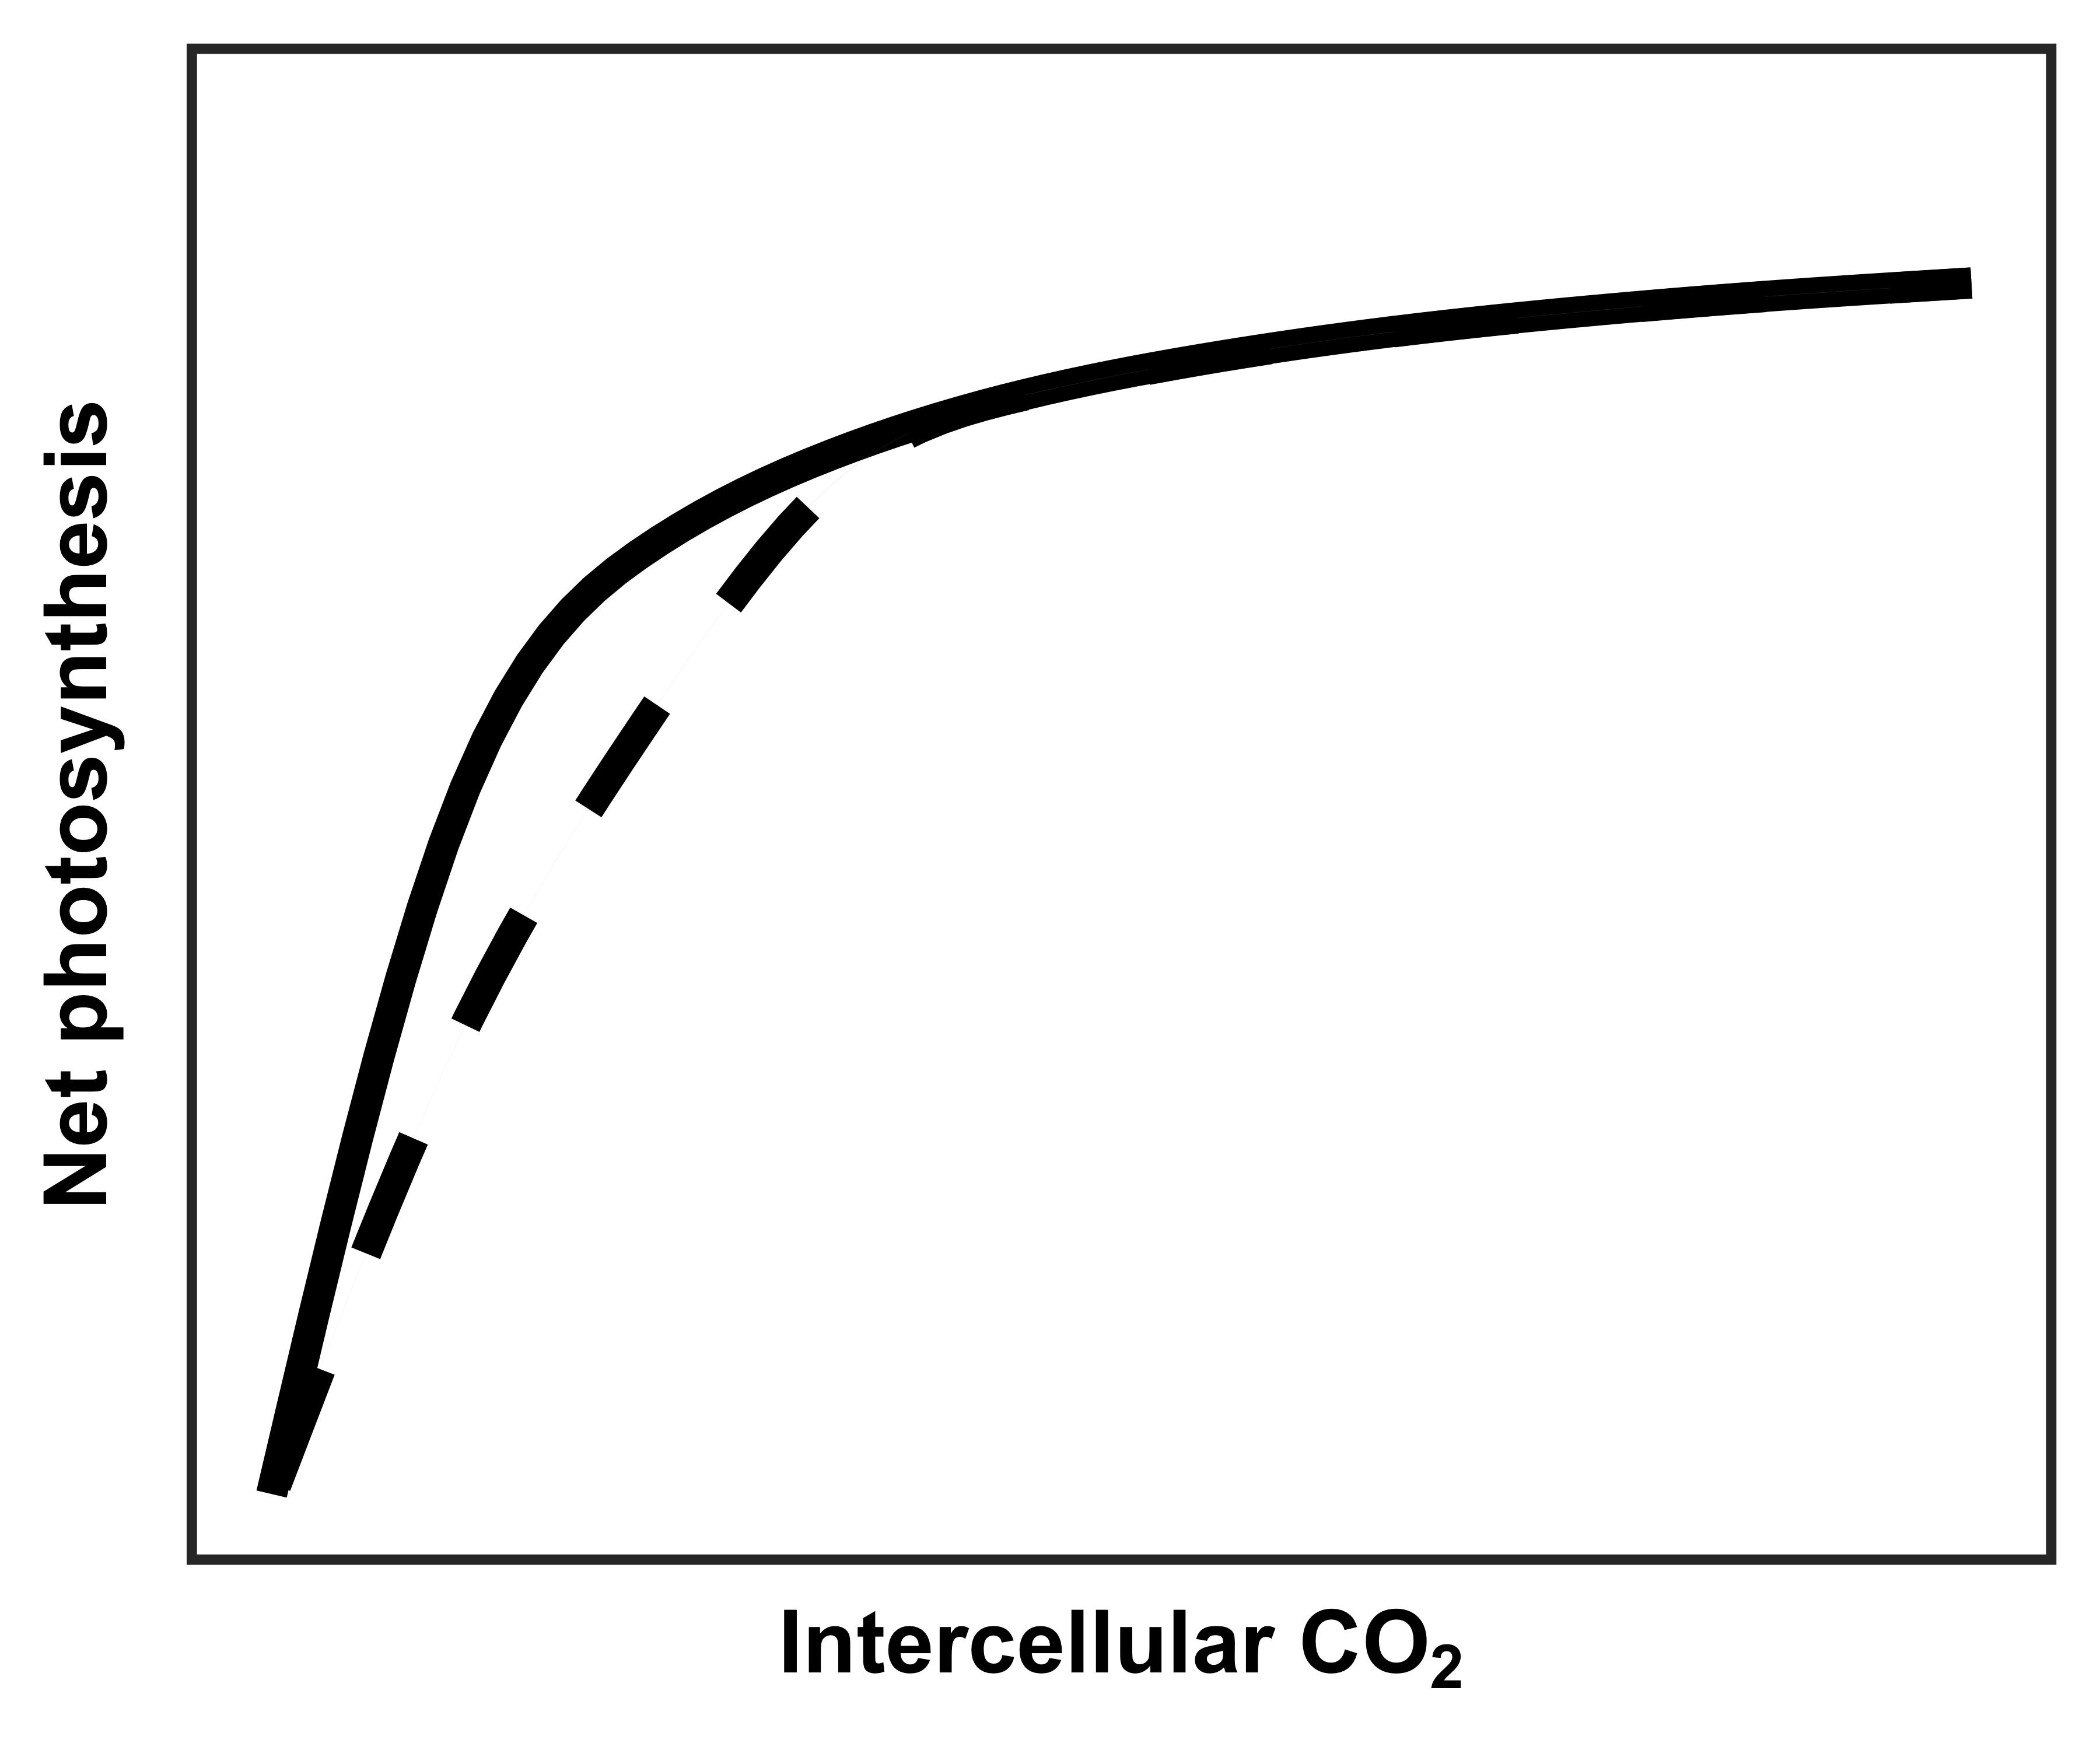
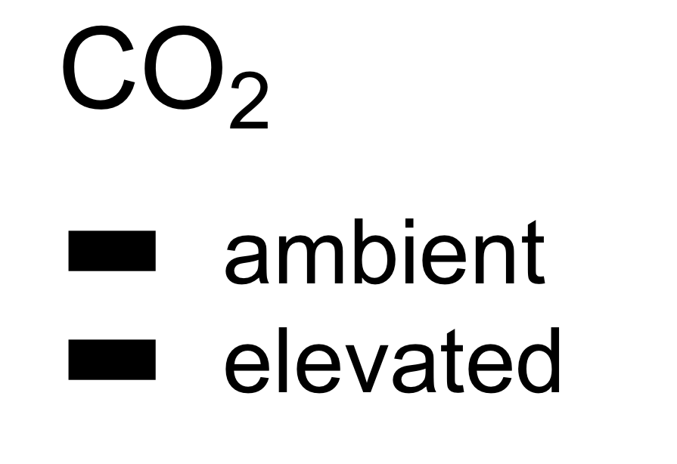
However, an alternative hypothesis suggests that plant demand to build and maintain photosynthetic enzymes drives the leaf response to CO₂
RuBP-limited photosynthesis
(A_{j})
Rubisco-limited photosynthesis
(A_{c})
net photosynthesis
at ambient CO₂
A_{c} = A_{j}
net photosynthesis
at elevated CO₂
Figure adapted from Moore et al. (1999) PC&E
Notes:
We expect these same optimal resource investments to occur under elevated CO2, but notice that the curve looks a bit different
The reduced initial slope, indicative of the maximum rate of Rubisco carboxylation, extends the portion of the curve that is limited by Rubisco carboxylation and CO2,
increasing the photosynthesis rate and the intercellular CO2 threshold where Rubisco limited photosynthesis equals RuBP limited photosynthesis
Rubisco-limited photosynthesis than RuBP-limited​ photosynthesis to achieve Ac = Aj

Slide 14
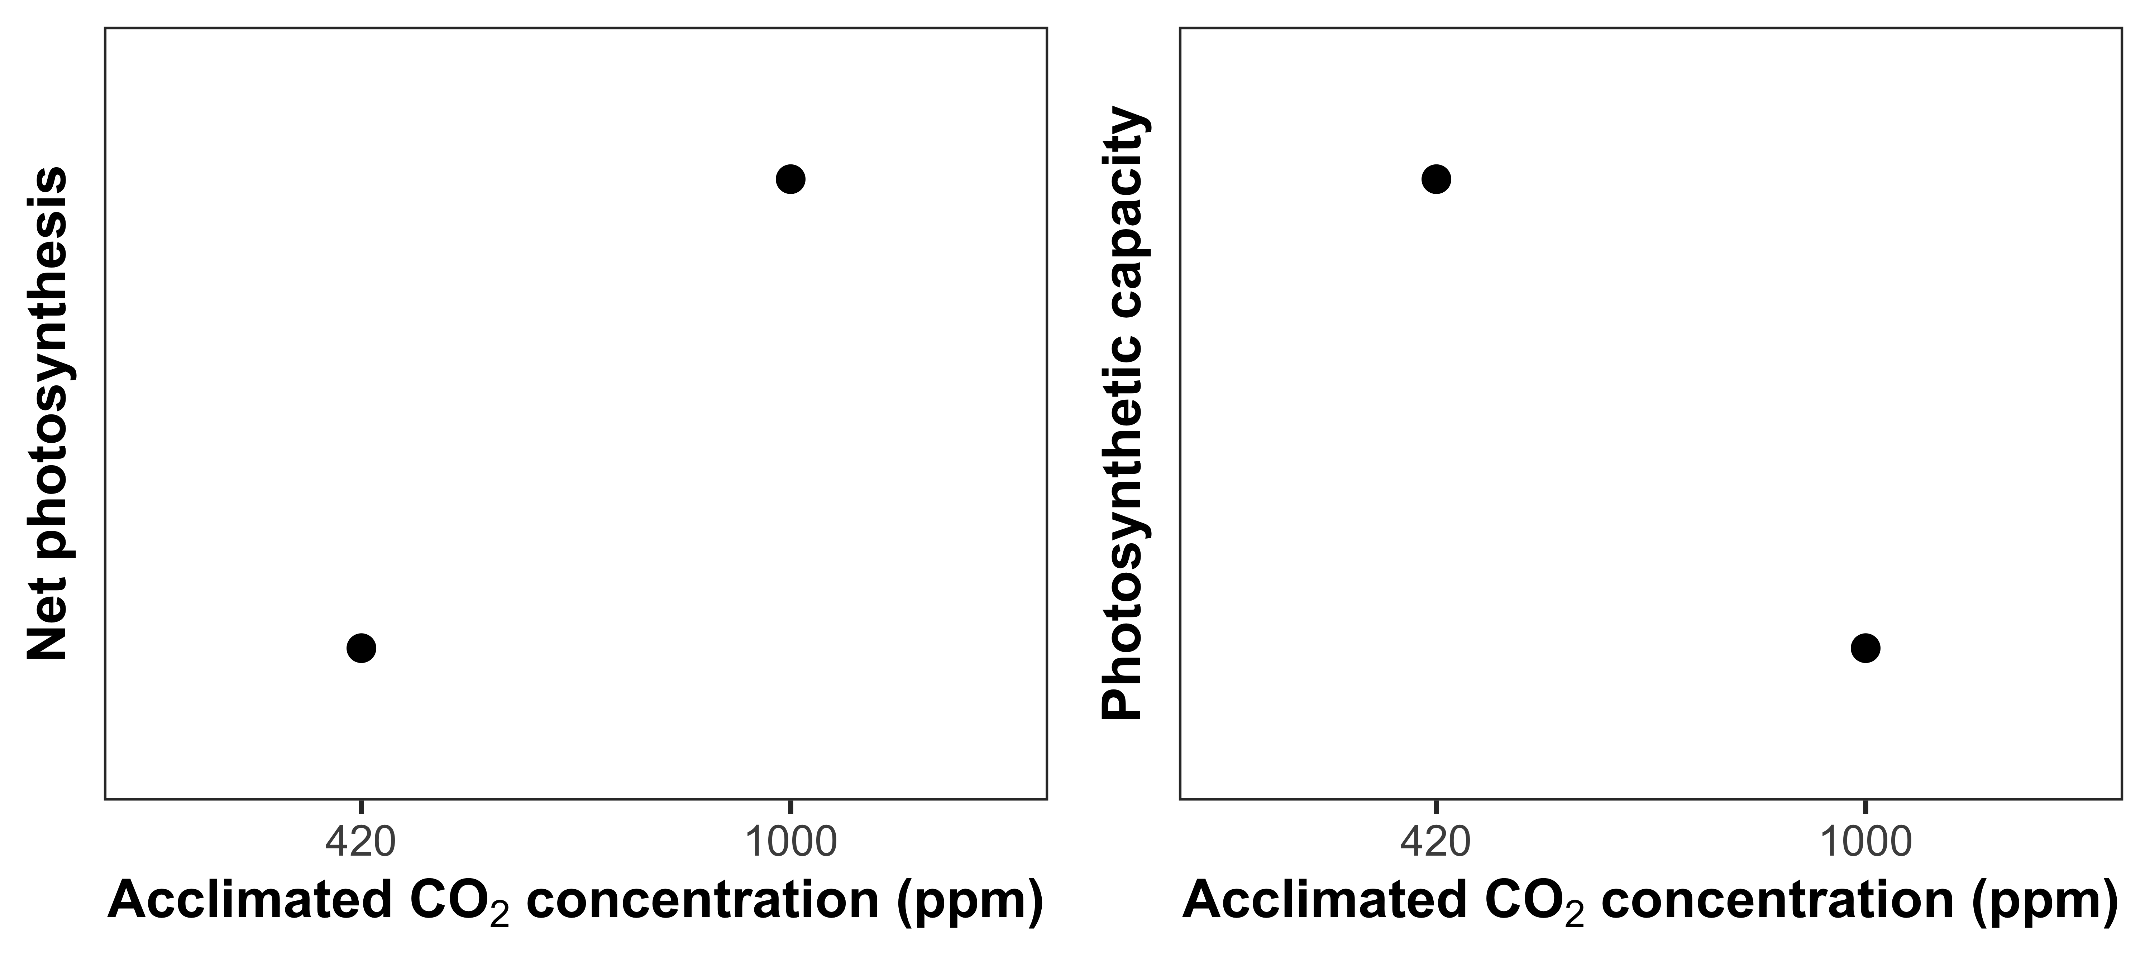
Optimal resource investment to photosynthetic enzymes increases leaf photosynthesis at lower photosynthetic capacity
Reduced photosynthetic capacity
Increased net photosynthesis
rate
Notes:
These patterns should result in plants grown under elevated CO2 having greater net photosynthesis rates and reduced photosynthetic capacity,
perhaps as a function of reduced leaf nitrogen allocation to photosynthetic tissue and increased nitrogen use efficiency

Slide 15
Study Question
How does soil nitrogen availability modify leaf and whole plant responses to CO₂?
Notes:
But the question remains: how does soil nitrogen availability modify leaf and whole plant responses to CO2?

Slide 16
Nitrogen limitation
hypothesis
Optimality
hypothesis
eCO₂
Photosynthetic capacity
eCO₂
Photosynthetic capacity
Soil N supply
Whole-plant growth
Soil N supply
Whole-plant growth
= net positive effect
= net negative effect
= null effect
Notes:
As a reminder, there are two primary hypotheses of note here:

Slide 17
Experiment setup
Acquisition strategy
Soil N treatments
0 ppm N
+ BNF
35 ppm N
- BNF
70 ppm N
105 ppm N
CO₂ treatments
140 ppm N
210 ppm N
ambient (420 ppm)
280 ppm N
elevated (1000 ppm)
350 ppm N
630 ppm N
Perkowski et al. (in prep)

Slide 18
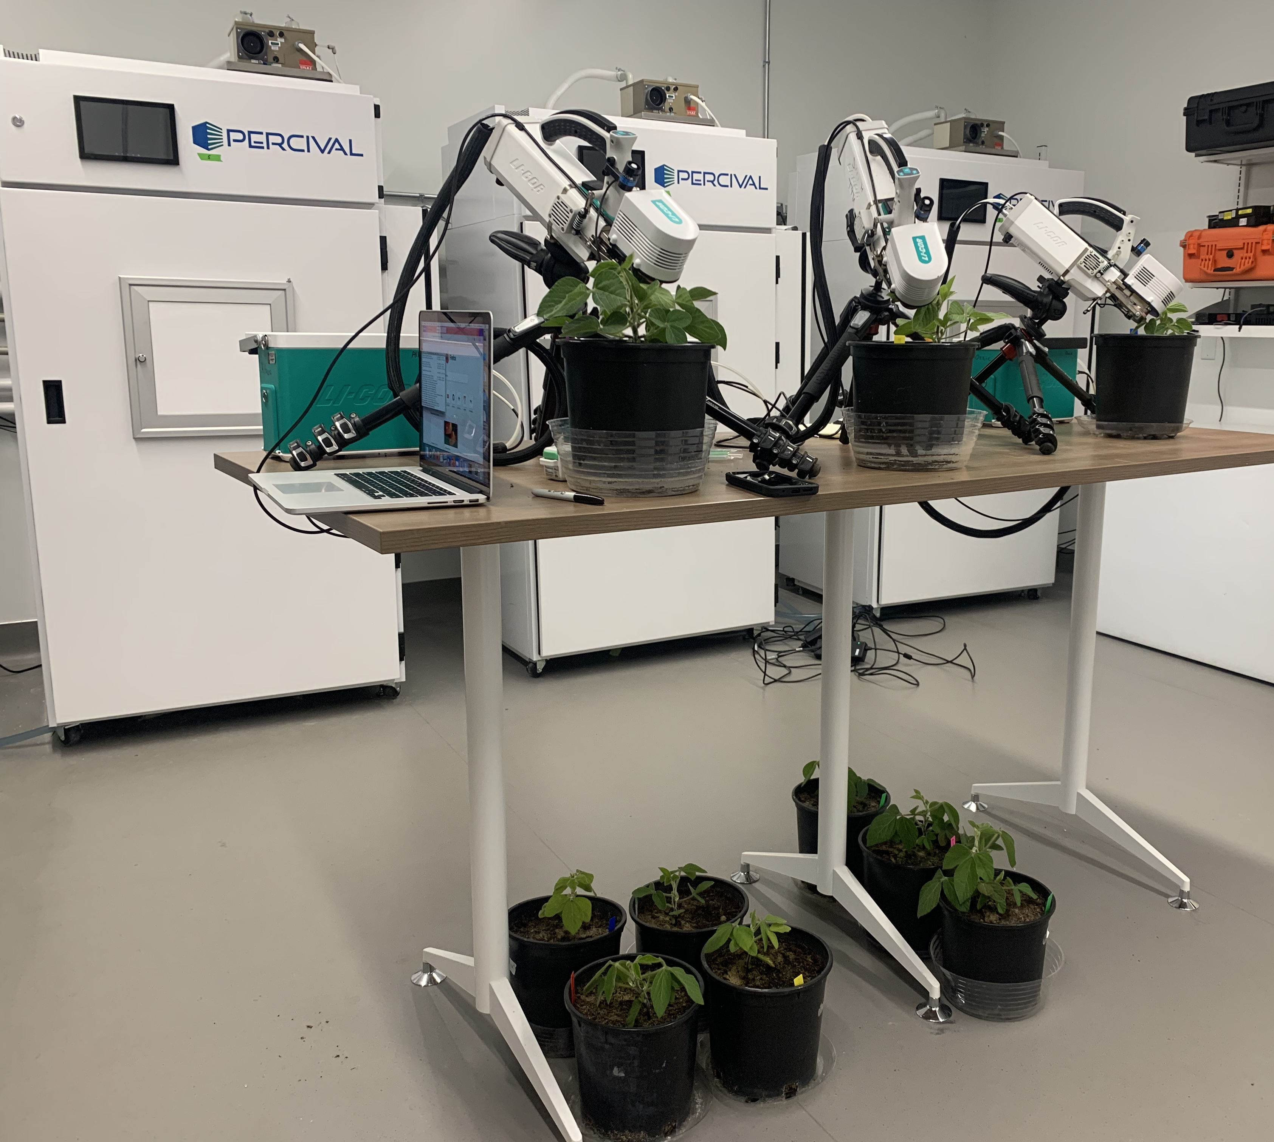
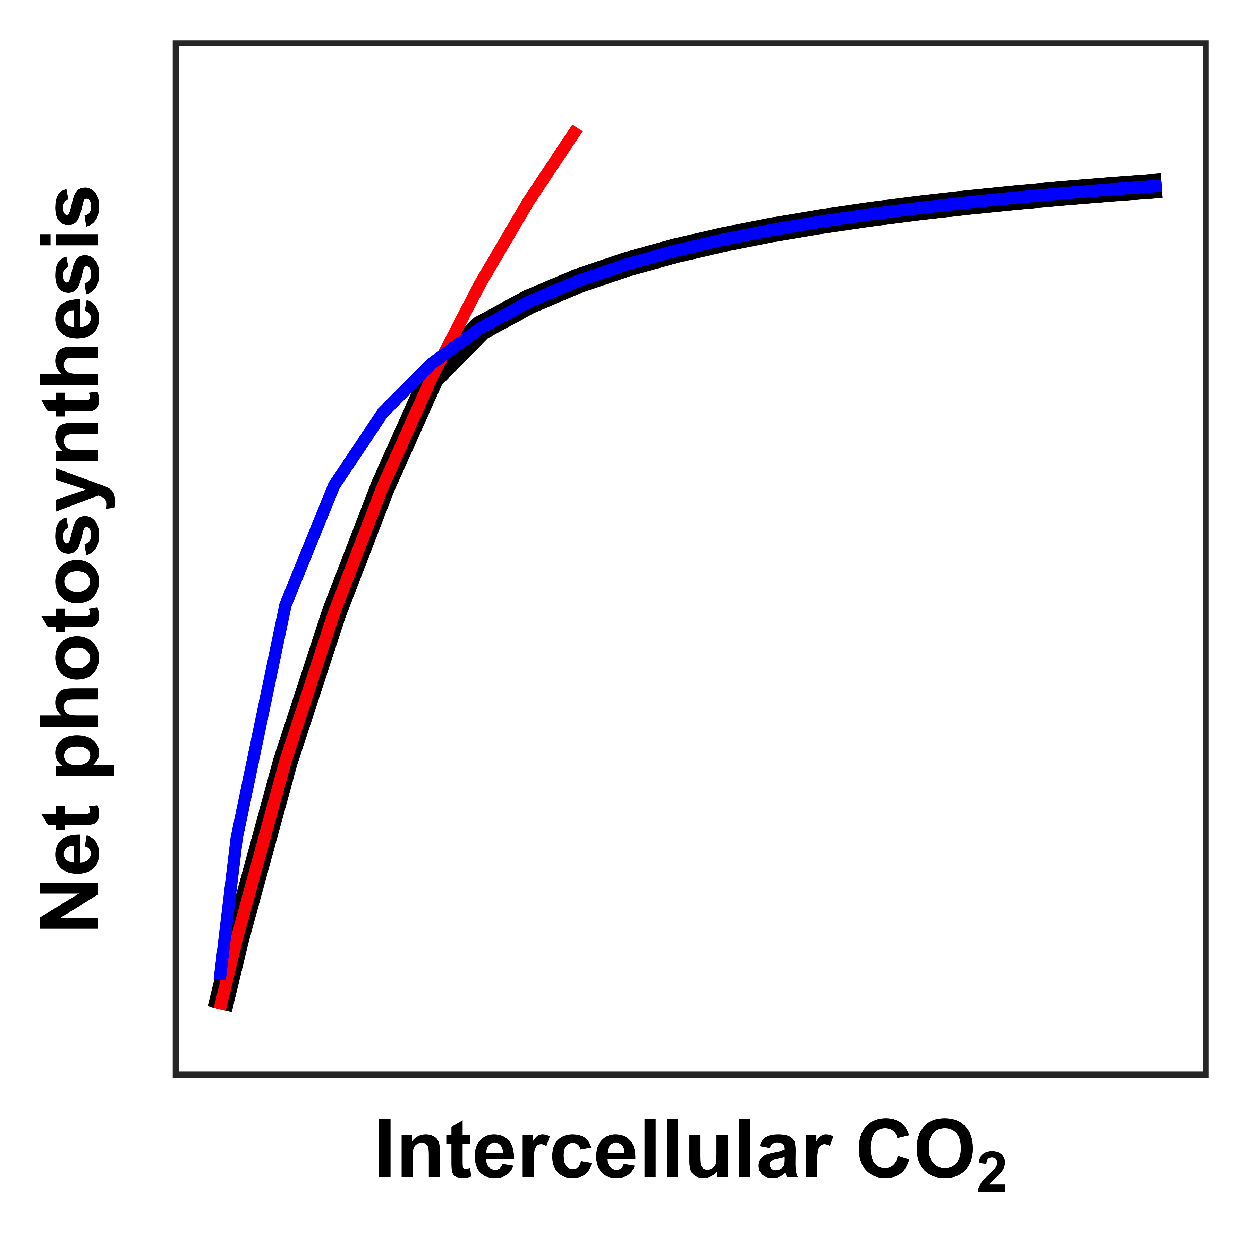
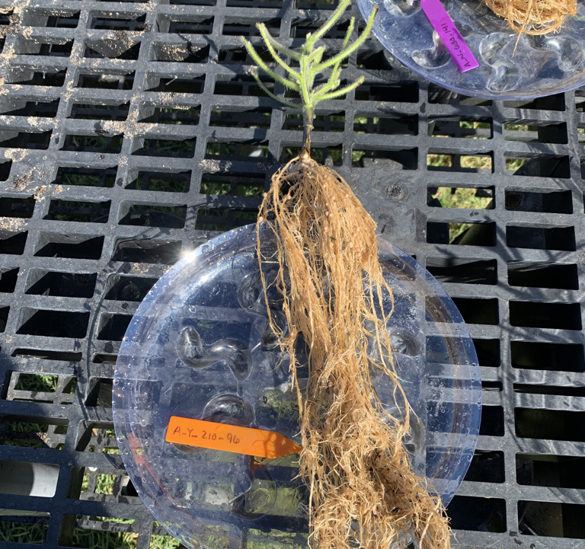
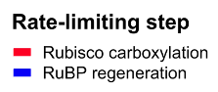
Measurements
Photosynthetic capacity
V_{cmax25}
J_{max25}
J_{max25}:V_{cmax25}
Total biomass
% leaf N derived from atmosphere
Perkowski et al. (in prep)

Slide 19
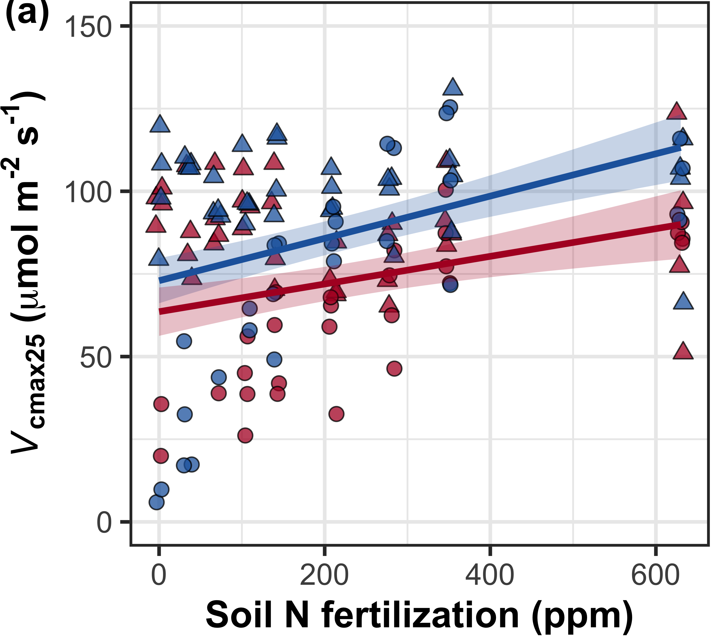
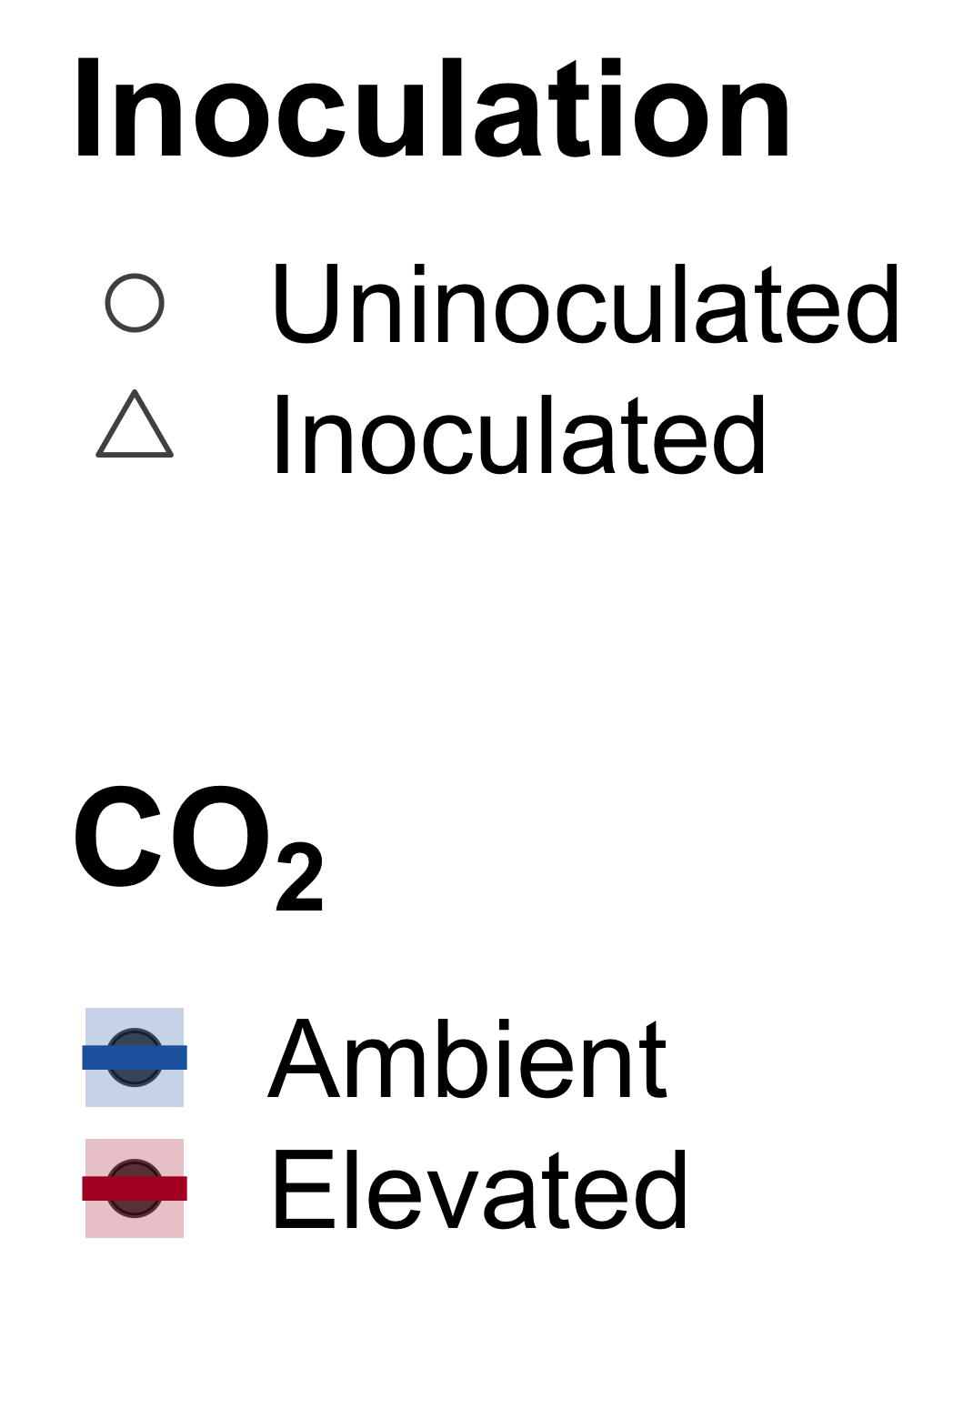
Increasing fertilization did not modify the reduction in photosynthetic capacity under elevated CO₂
CO₂: | p<0.001
Fertilization (N): | p<0.001
Inoculation (I): | p<0.001
CO₂*N interaction: | NS
CO₂*I interaction: | NS
N*I interaction: | p<0.001
CO₂
CO₂
Notes:
Elevated CO2 reduced leaf biochemical process rates
Soil nitrogen fertilization generally increased leaf biochemical process rates, but the slope of this relationship was similar between both CO2 treatments
Indicates that the reduction in photosynthetic capacity under elevated CO2 was independent of fertilization

Slide 20
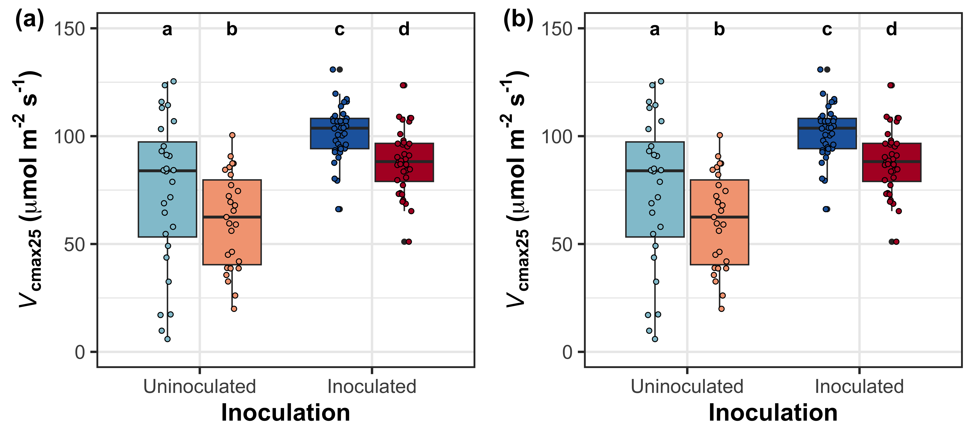
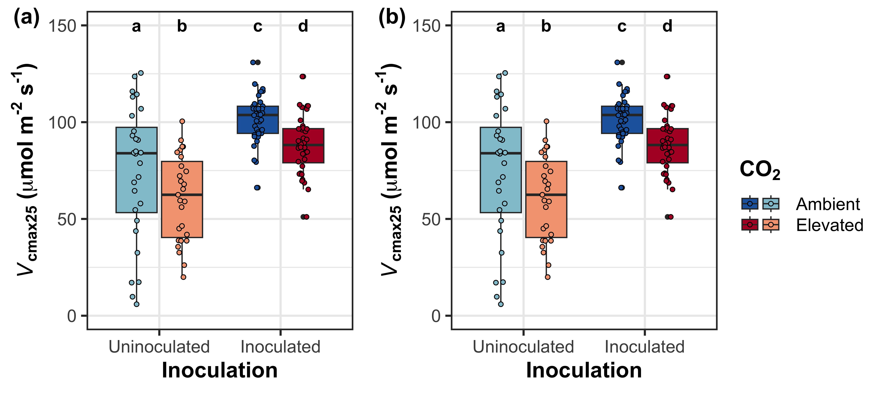
Inoculation also did not modify the reduction in photosynthetic capacity under elevated CO₂
CO₂: | p<0.001
Fertilization (N): | p<0.001
Inoculation (I): | p<0.001
CO₂*N interaction: | NS
CO₂*I interaction: | NS
N*I interaction: | p<0.001
CO₂
CO₂
Notes:
Inoculation with symbiotic nitrogen fixing bacteria generally increased photosynthetic capacity,
but the effect of elevated CO2 was similar between inoculation treatments,
suggesting that the CO2 effect was independent of inoculation

Slide 21
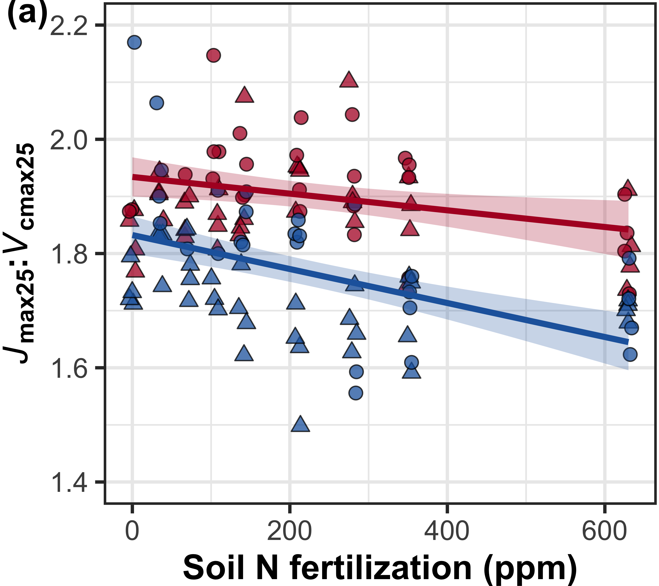
Elevated CO₂ decreased V_{cmax25} more strongly than J_{max25}. Fertilization did not modify this effect
CO₂: | p<0.001
Fertilization (N): | p<0.001
Inoculation (I): | p<0.001
CO₂*N interaction: | NS
CO₂*I interaction: | NS
CO₂
CO₂
Notes:
Elevated CO2 increased the ratio of Jmax25 to Vcmax25 due to a stronger downregulation in Vcmax25 than Jmax25
Fertilization generally decreased this ratio, but again the slope of this relationship was similar between both CO2 treatments,
suggesting that elevated CO2 did not modify relative allocation between Jmax25 and Vcmax25

Slide 22
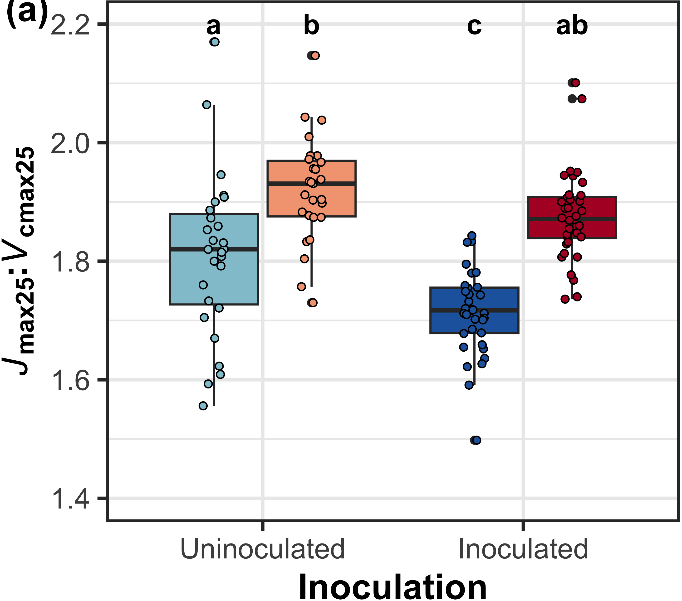
Elevated CO₂ decreased V_{cmax25} more strongly than J_{max25}. Inoculation did not modify this effect
CO₂: | p<0.001
Fertilization (N): | p<0.001
Inoculation (I): | p<0.001
CO₂*N interaction: | NS
CO₂*I interaction: | NS
CO₂
CO₂
Notes:
Inoculation with symbiotic nitrogen fixing bacteria generally increased the ratio of Jmax25 to Vcmax25,
but the effect of elevated CO2 was similar between inoculation treatments,
suggesting that the CO2 effect was independent of inoculation

Slide 23
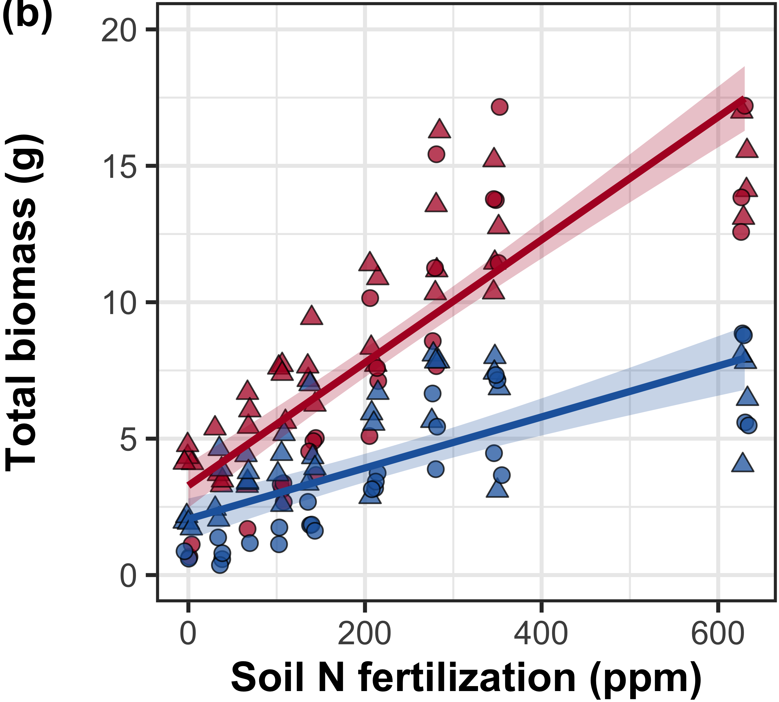
Increasing fertilization increased the positive effect of elevated CO₂ on whole-plant growth
CO₂: | p<0.001
Fertilization (N): | p<0.001
Inoculation (I): | p<0.001
CO₂*N interaction: | p<0.001
CO₂*I interaction: | NS
CO₂
CO₂
Perkowski et al. (in prep)
Notes:
Despite reductions in photosynthetic capacity and leaf nitrogen allocation at the leaf level,
whole plant growth was greater under elevated CO2
Increasing fertilization increased total biomass, an effect that was stronger under elevated CO2 than ambient CO2
This result suggests that nitrogen availability plays an important role in regulating whole plant responses to elevated CO2

Slide 24
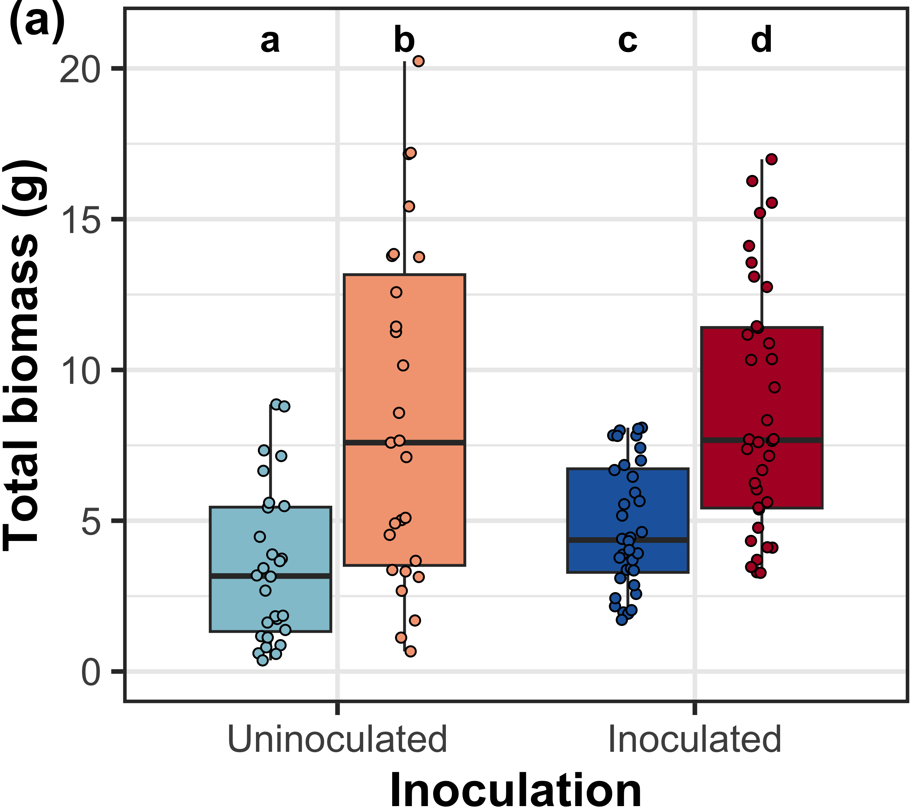
Inoculation did not modify the positive effect of eCO₂ on total biomass
CO₂: | p<0.001
Fertilization (N): | p<0.001
Inoculation (I): | p<0.001
CO₂*N interaction: | p<0.001
CO₂*I interaction: | NS
CO₂
CO₂
Notes:
Inoculation with symbiotic nitrogen fixing bacteria generally increased total biomass,
but the effect of elevated CO2 was similar between inoculation treatments,
suggesting that the CO2 effect was independent of inoculation

Slide 25
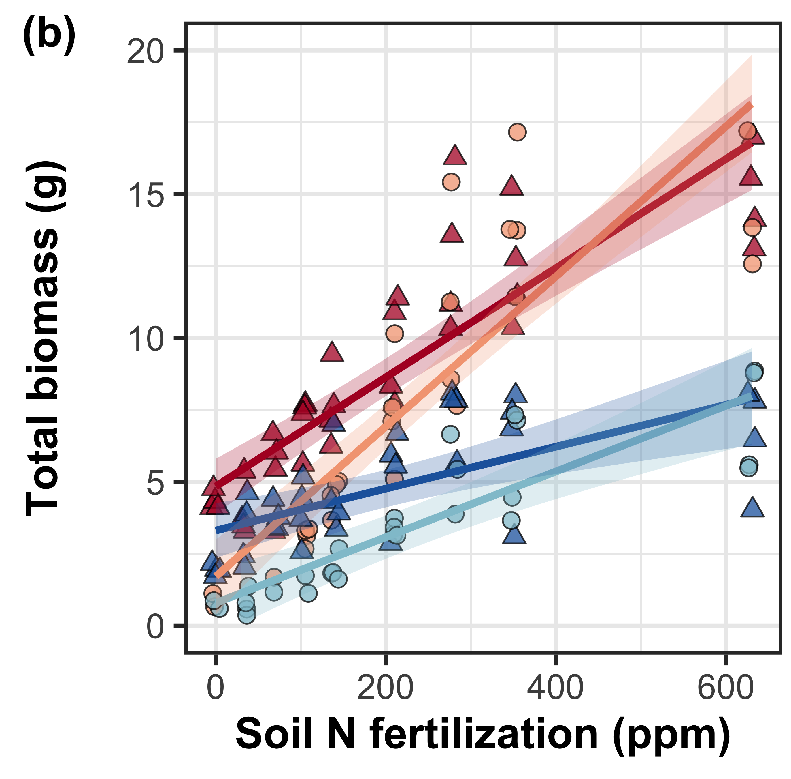
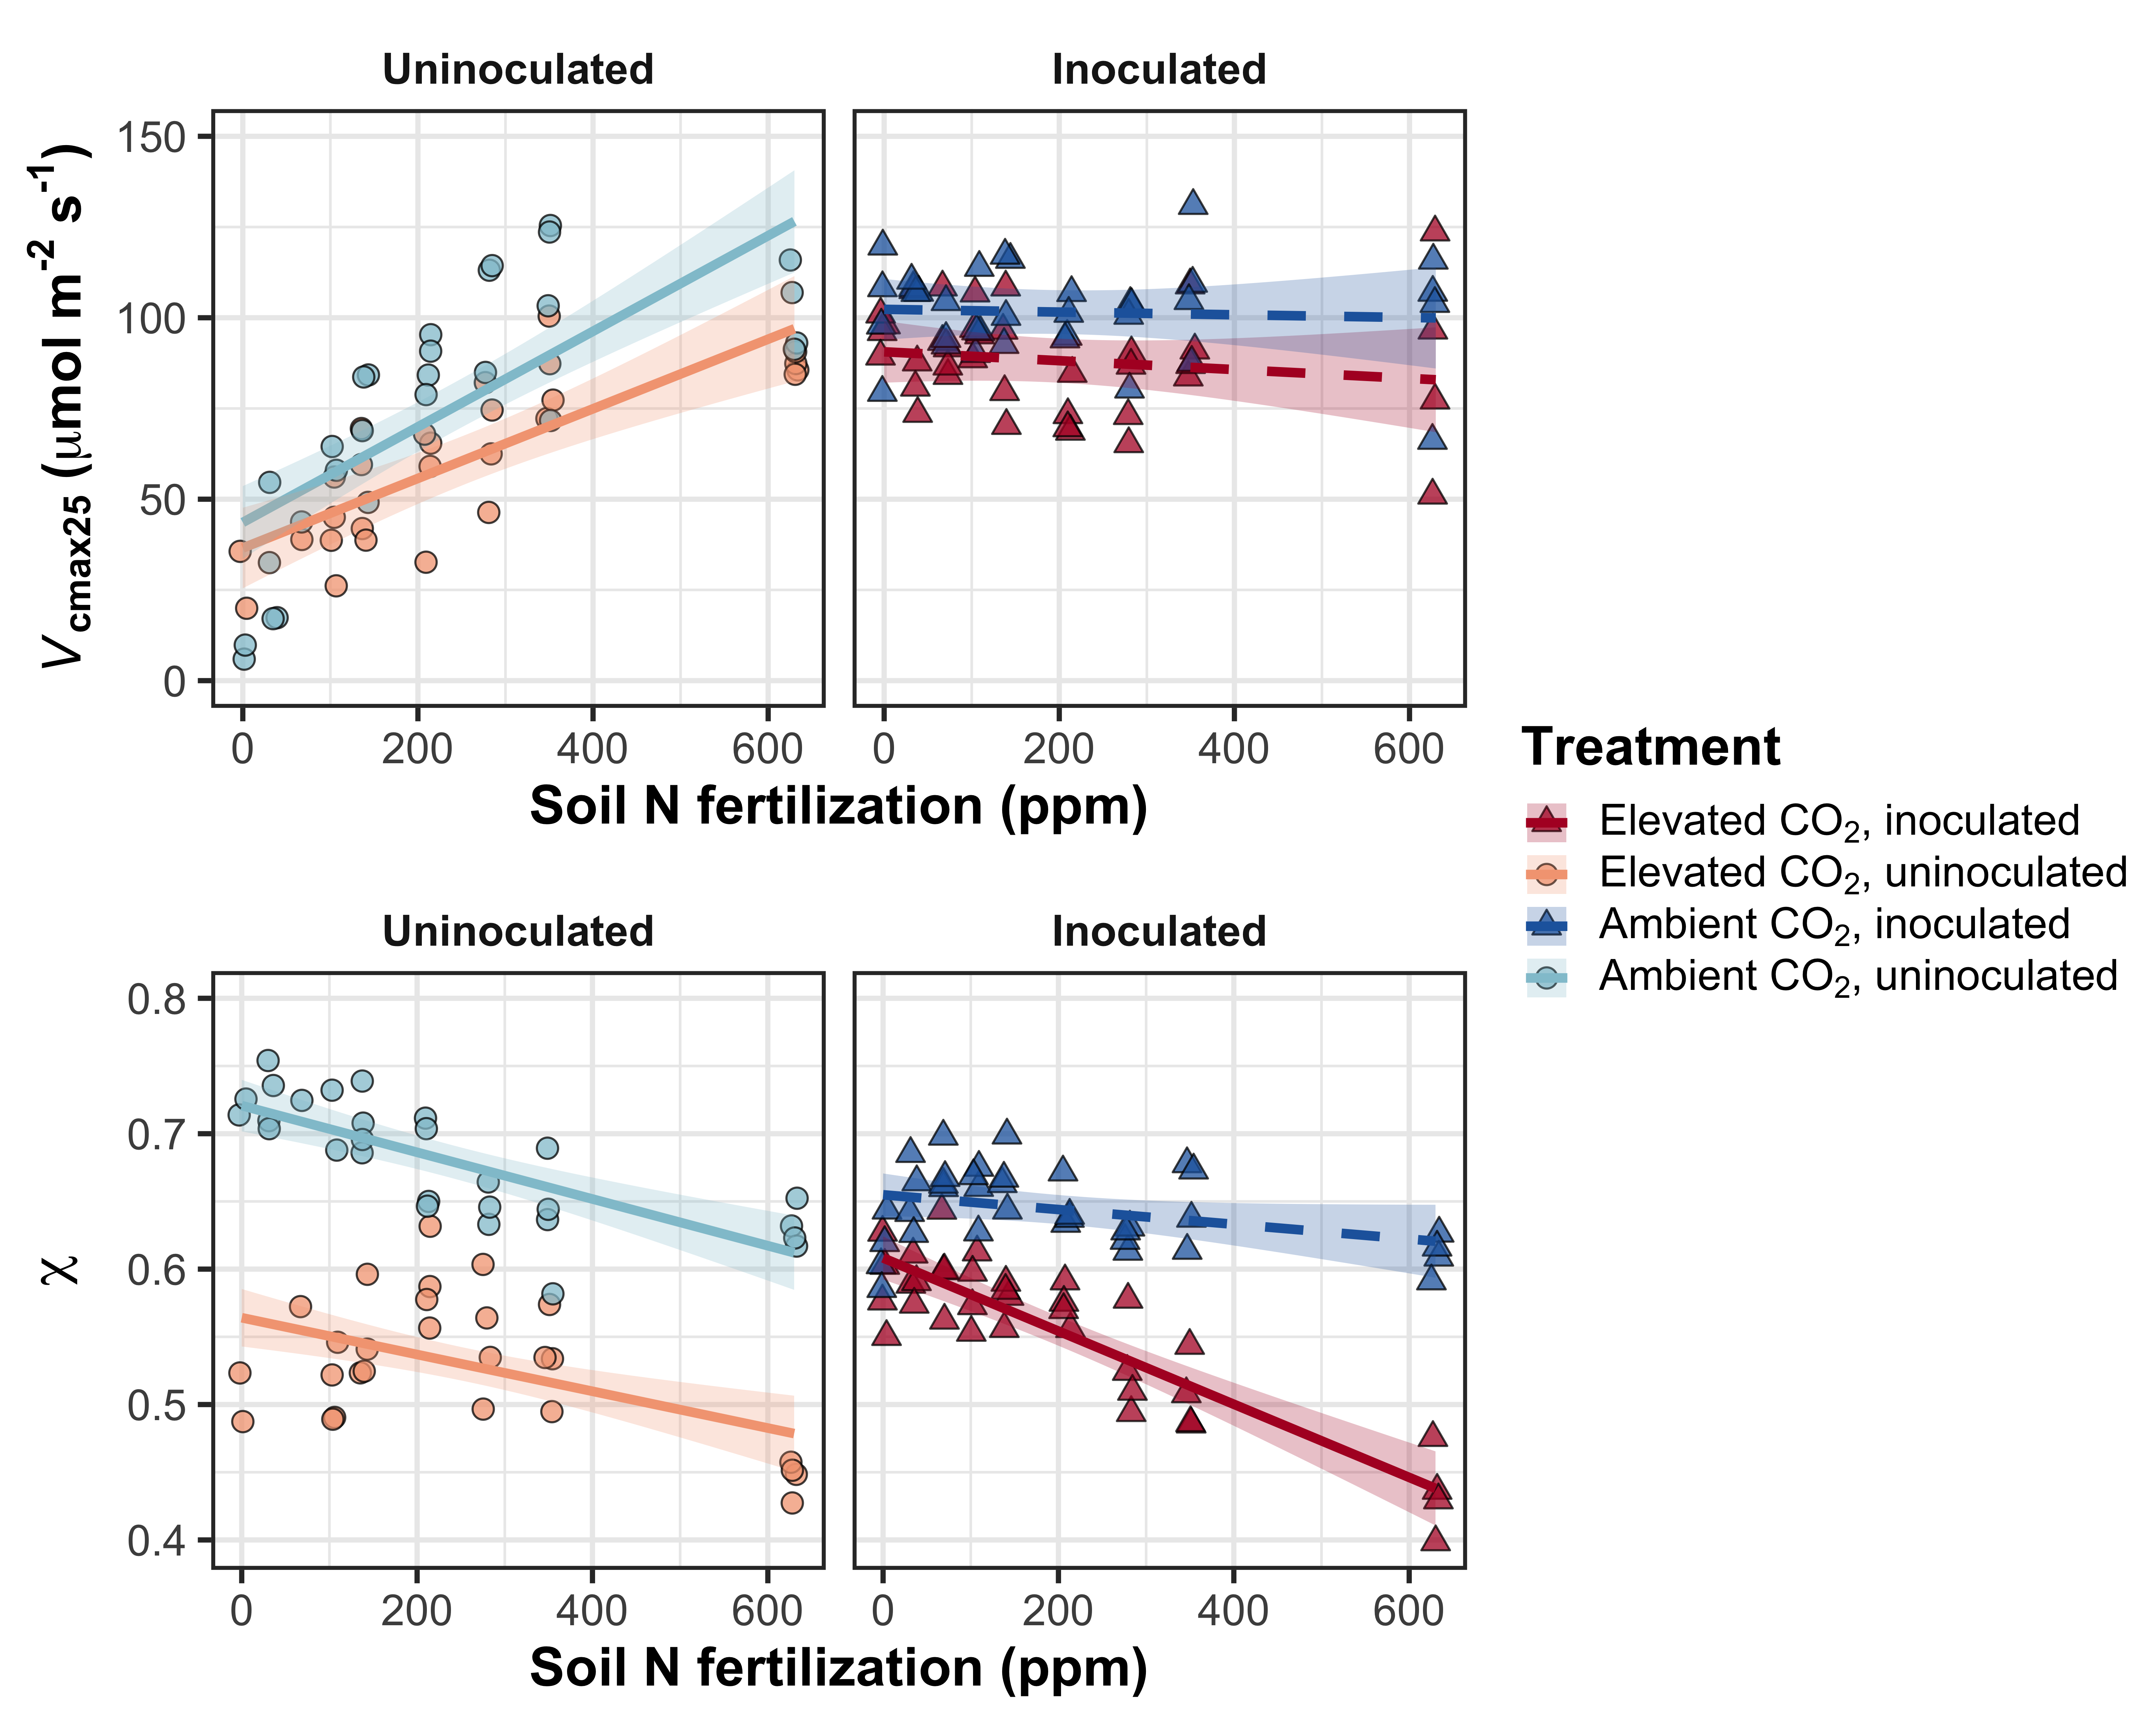
However, inoculated plants had greater total biomass under low fertilization
CO₂: | p<0.001
Fertilization (N): | p<0.001
Inoculation (I): | p<0.001
CO₂*N interaction: | p<0.001
CO₂*I interaction: | NS
N*I interaction: | p<0.001
Perkowski et al. (in prep)
Notes:
However, inoculated plants did tend to have greater total biomass under low fertilization

Slide 26
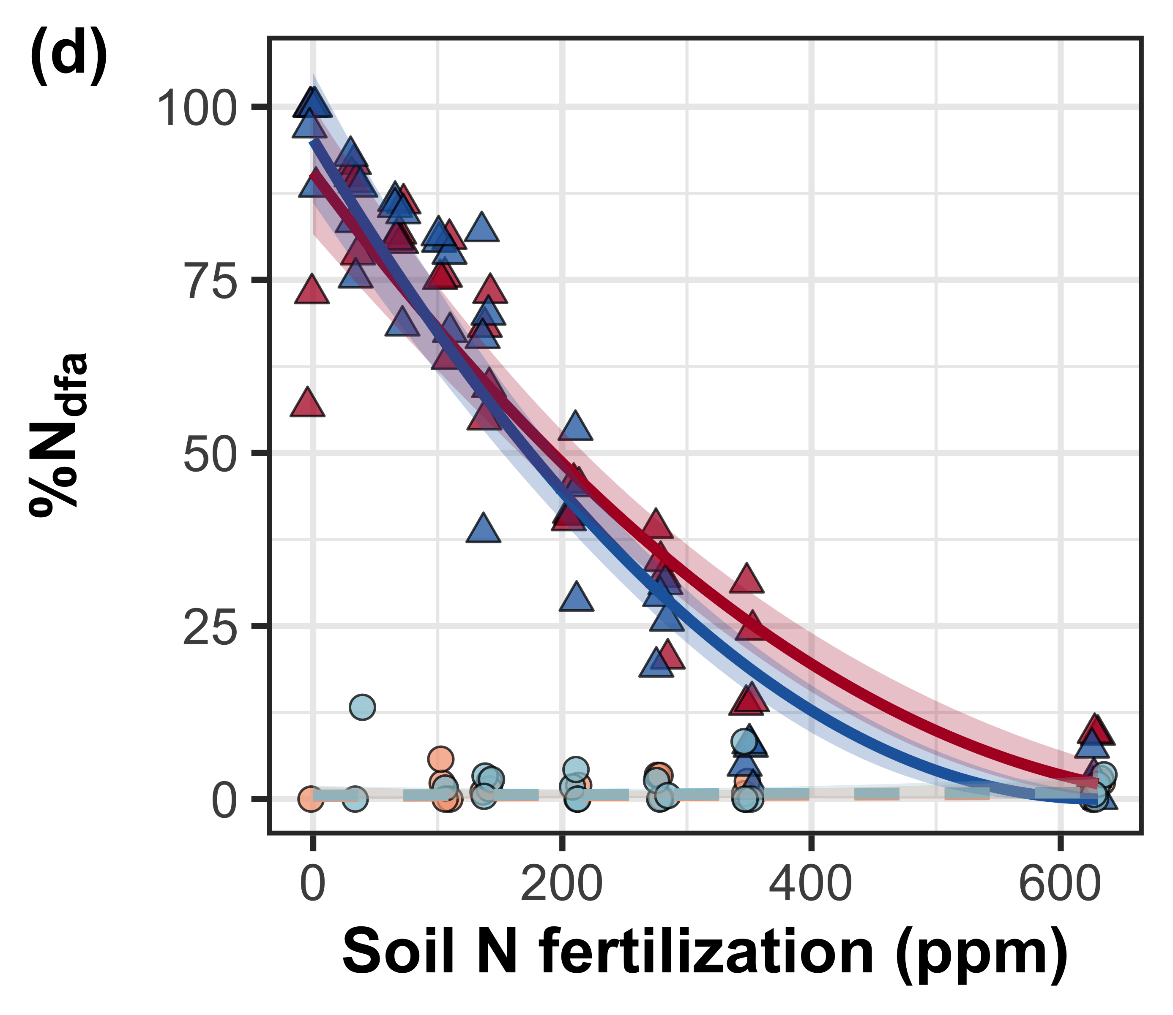
Increasing fertilization decreased the percent of leaf nitrogen content derived from the atmosphere
CO₂: | NS
Fertilization (N): | p<0.001
Inoculation (I): | p<0.001
CO₂*N interaction: | NS
CO₂*I interaction: | NS
N*I interaction: | p<0.001
Notes:
A response that was likely driven by high investment in nitrogen fixation under low fertilization

Slide 27
Conclusions
N demand and supply control plant responses to eCO₂ at different scales
N supply → whole-plant response to eCO₂
N demand → leaf response to eCO₂
Leaf and whole plant responses to fertilization are dependent on acquisition strategy
eCO₂
Photosynthetic capacity
Soil N supply
Whole-plant growth

Slide 28
Increasing fertilization increased photosynthetic capacity, but only in uninoculated plants

Slide 29
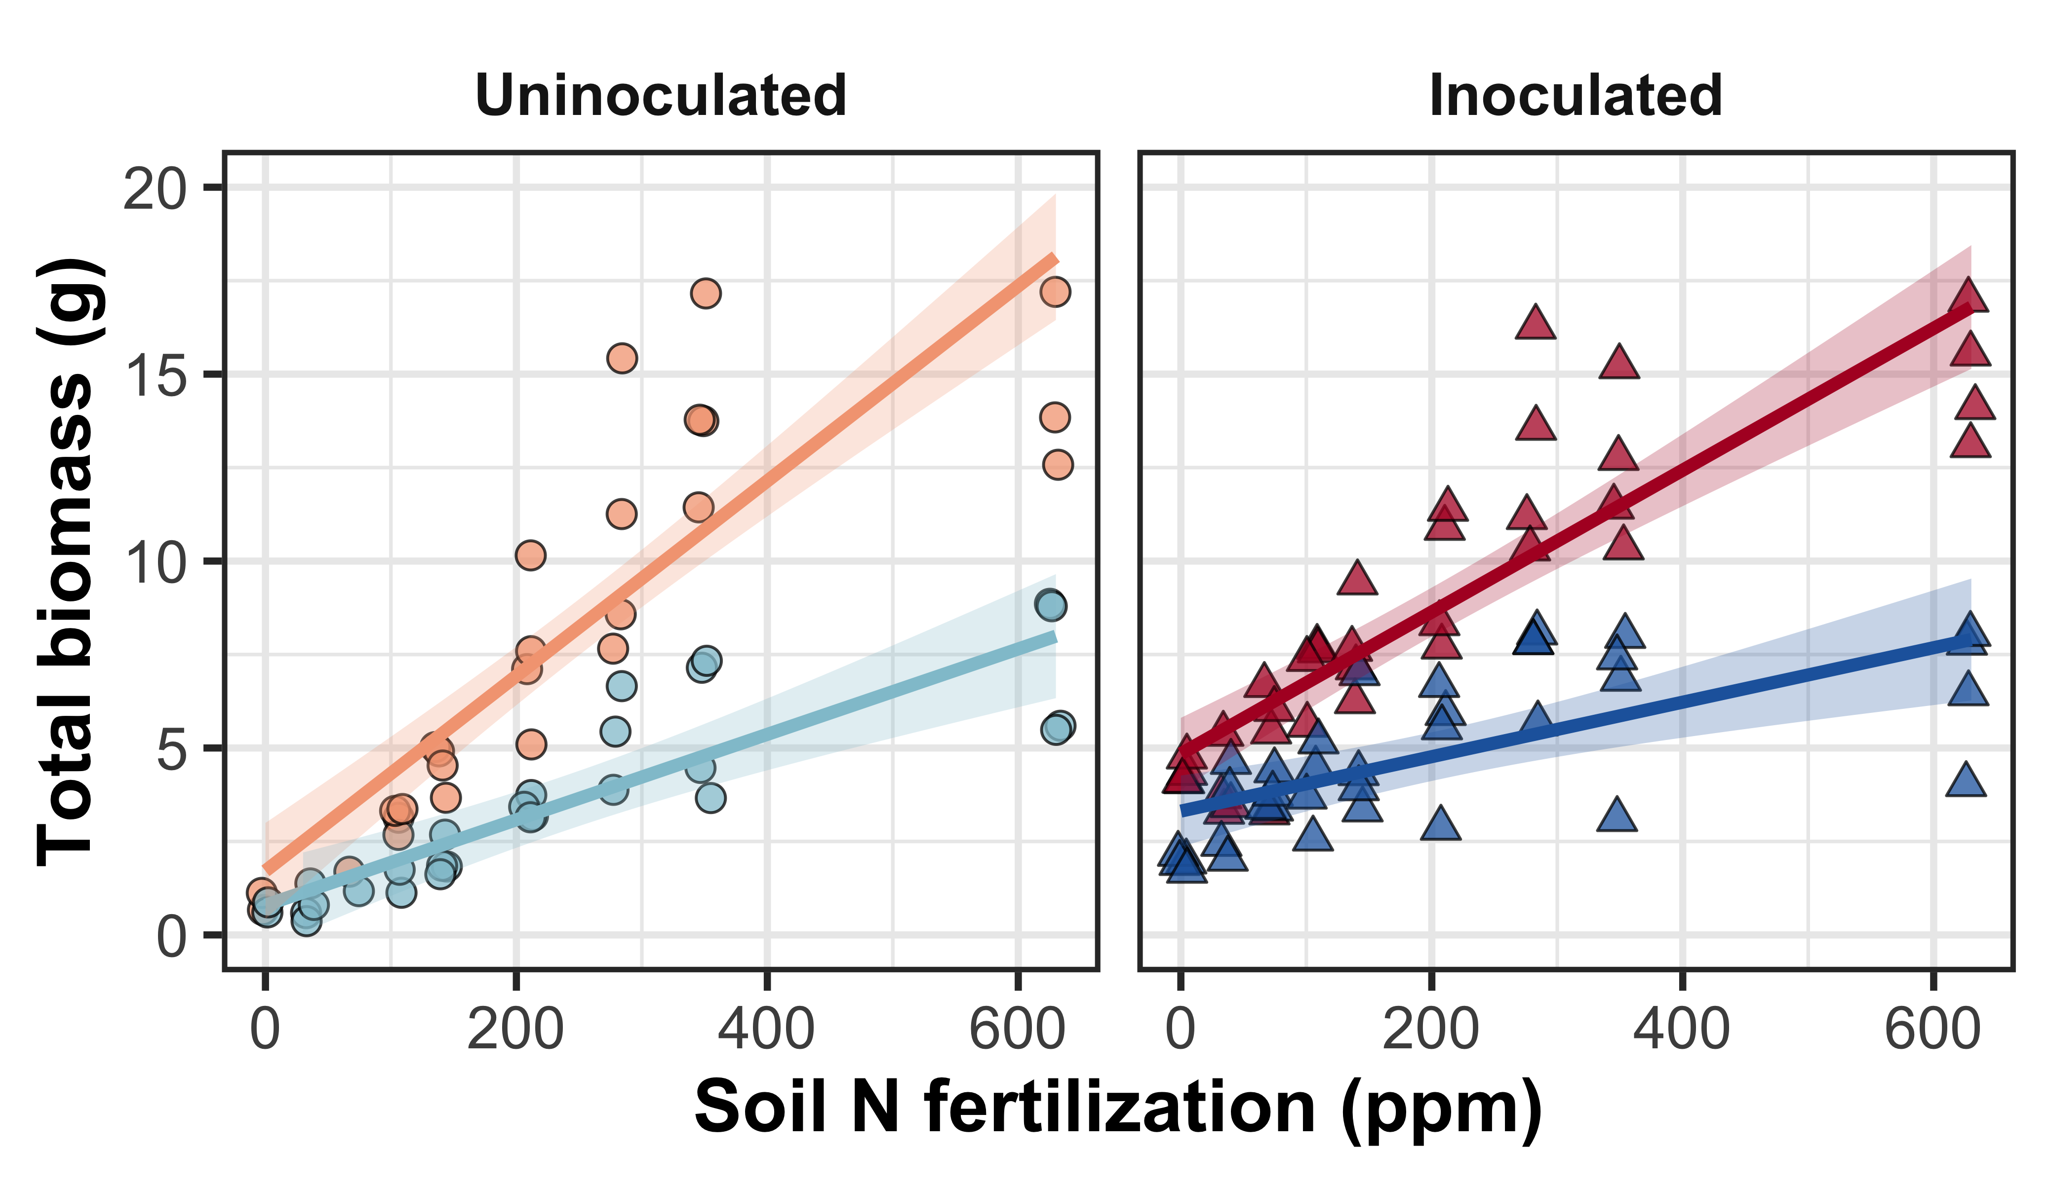
Increasing fertilization increased total biomass more strongly in uninoculated plants

Slide 30
Conclusions
N demand and supply control plant responses to eCO₂ at different scales
N supply → whole-plant response to eCO₂
N demand → leaf response to eCO₂
Plant responses to fertilization are dependent on acquisition strategy
eCO₂
Photosynthetic capacity
Soil N supply
Whole-plant growth

Slide 31
Conclusions
N demand and supply control plant responses to eCO₂ at different scales
N supply → whole-plant response to eCO₂
N demand → leaf response to eCO₂
Plant responses to fertilization are dependent on acquisition strategy
eCO₂
Photosynthetic capacity
Soil N supply
Whole-plant growth
Acquisition strategy

Slide 32

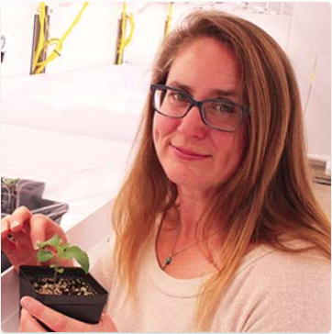




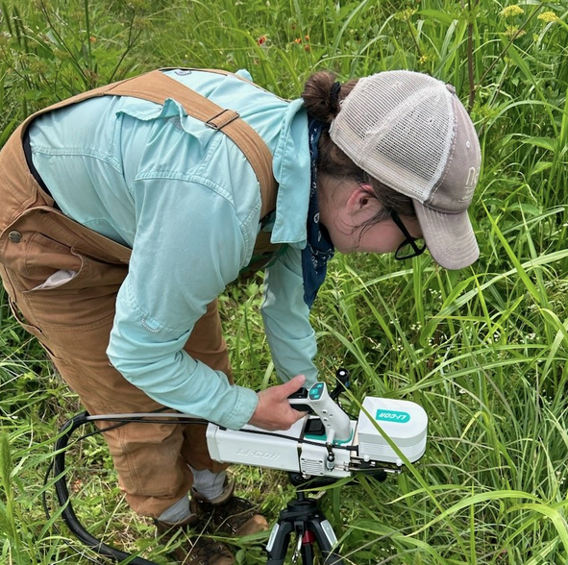




Acknowledgements
Mylea Lovell
TTU Phytotron manager
Alissar Cheaib
Smith Lab Post-doc
Brad Posch
Former Smith Lab Post-doc
Kelly Carroll
Smith Lab Manager
Eve Gray
Smith Lab MS student
Monika Kelly
Smith Lab MS student
Isa Beltran
Smith Lab MS student
Snehanjana Chatterjee
Smith Lab PhD student
Hannah German
Smith Lab UG student

Slide 33
Thank you!

